Slide 1


Weston Gorospe
July 1, 2023

Slide 2

Outline
Executive Summary
Introduction
Methodology
Results
Conclusion
Appendix

Slide 3
Executive Summary
Summary of methodologies
Data Collection through API
Data Collection with Web Scraping
Data Wrangling
Exploratory Data Analysis with SQL
Exploratory Data Analysis with Data Visualization
Interactive Visual Analytics with Folium
Machine Learning Prediction
Summary of all results
Exploratory Data Analysis result
Interactive analytics in screenshots
Predictive Analytics result

Slide 4
Introduction
Project background and context
SpaceY, founded by Allon Mask, is an aerospace company looking to compete with SpaceX. Gathering information using SpaceX launch data, the cost of each launch can be determined. It can also be determined whether or not the first stage will be reused. Various methods were used to gather data, analyze the data, predict future outcomes with machine learning, and finally present the findings.
Problems you want to find answers
Cost of each launch
Reuse of the first stage
Factors affecting the success of each launch

Slide 5

Section 1

Slide 6
Methodology
Executive Summary
Data collection methodology:
SpaceX REST API
Web Scraping from Wikipedia
Perform data wrangling
One-Hot Encoding categorical data
Dropping irrelevant categories
Perform exploratory data analysis (EDA) using visualization and SQL
Perform interactive visual analytics using Folium and Plotly Dash
Perform predictive analysis using classification models
How to build, tune, evaluate classification models

Slide 7




Data Collection
Data collection is the process of gathering and measuring information on targeted variables in an established system, which then enables one to answer relevant questions and evaluate outcomes.
Fetch data (API or web scraping)
Clean data
Use file as needed
Read data into notebook as data frame
Export to flat file

Slide 8

Data Collection – SpaceX API
Data was requested from the SpaceX API. Data returned as a json which was read and placed into a data frame.
Notebook link: https://github.com/Wgorospe/IBM-Data-Science-Capstone/blob/main/SpaceX%20API%20Data%20Collection.ipynb
Place your flowchart of SpaceX API calls here

Slide 9

Data Collection - Scraping
Web scraping was performed on Wikipedia. Get method returned an HTML response and BeautifulSoup was used to extract the data into a csv.
Notebook link: https://github.com/Wgorospe/IBM-Data-Science-Capstone/blob/main/Webscraping%20SpaceX%20Launch%20Data.ipynb
Place your flowchart of web scraping here

Slide 10

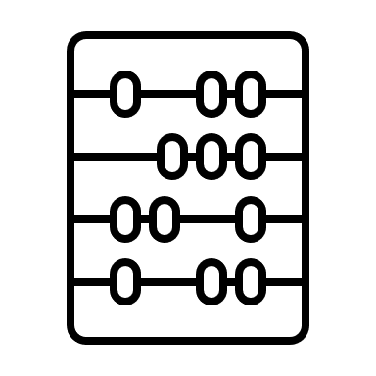
Data Wrangling
Data wrangling is the process of cleaning and unifying messy and complex data sets for analysis.
Notebook Link: https://github.com/Wgorospe/IBM-Data-Science-Capstone/blob/main/Space%20X%20Data%20Wrangling%20Landing%20Data.ipynb
Check for Null values and outliers
Fill in nulls and replace outliers
Perform analysis
Calculate relevant values and save as a variable
Save to dataframe

Slide 11
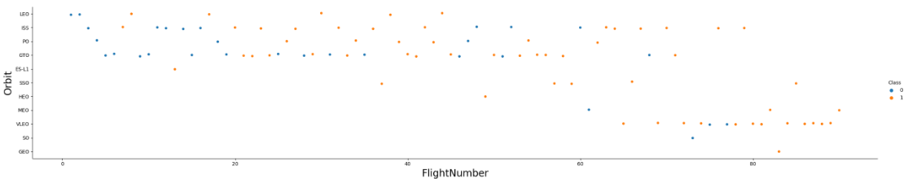
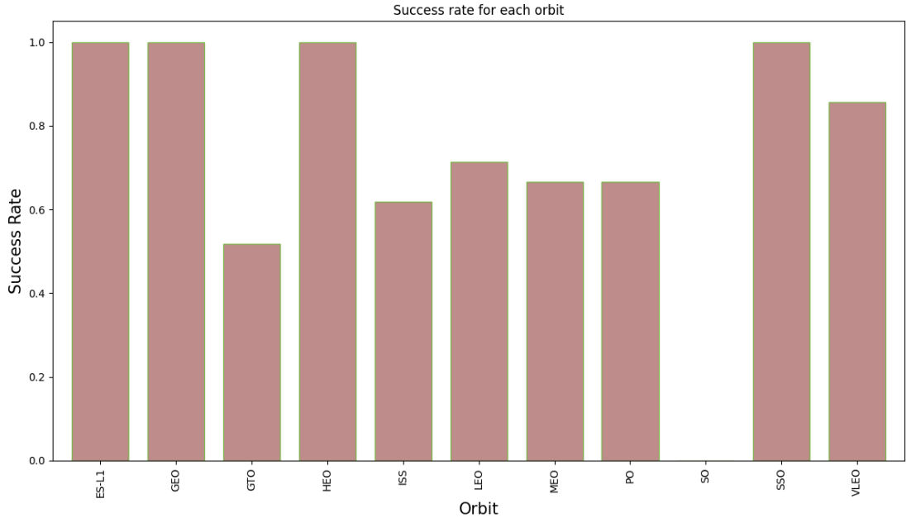
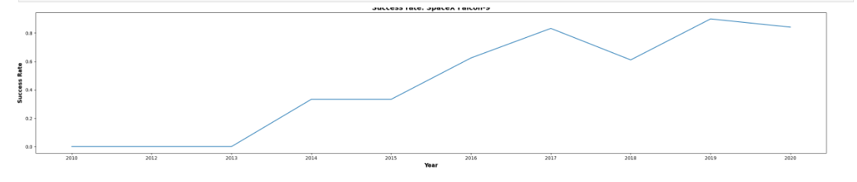
EDA with Data Visualization
Simple calculations were completed to display any correlations in the variables. They were then visualized on various charts.
Notebook Link: https://github.com/Wgorospe/IBM-Data-Science-Capstone/blob/main/SpaceX%20Flight%20Data%20Visualization.ipynb

Slide 12
EDA with SQL
SQL queries were then performed to better understand the data using SQLalchemy. Example queries were:
Ranking the count of landing outcomes within a time period
Listing the names of boosters where the payload was at maximum capacity
Listing the date of the first successful landing
Displaying the total payload of all boosters from NASA
Notebook link: https://github.com/Wgorospe/IBM-Data-Science-Capstone/blob/main/SpaceX%20Data%20SQL%20Query%20.ipynb

Slide 13

Build an Interactive Map with Folium
Map markers were used to determine an optimal location for building a launch site
Notebook link: https://github.com/Wgorospe/IBM-Data-Science-Capstone/blob/main/SpaceX%20Folium%20Analysis.ipynb

Slide 14
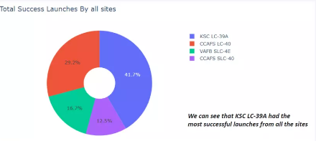
Build a Dashboard with Plotly Dash
An interactive dashboard was built with Plotly dash
Pie charts with total launches grouped by launch sites
A scatter plot showing the relationship between Landing Outcome and Payload Mass (Kg) for different booster versions
Notebook link: https://github.com/Wgorospe/IBM-Data-Science-Capstone/blob/main/spacex_dash_app.py

Slide 15
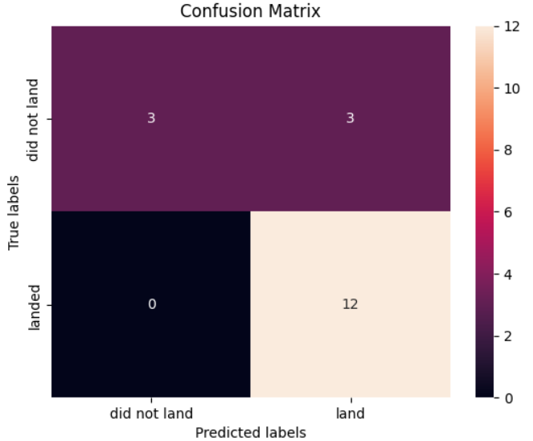
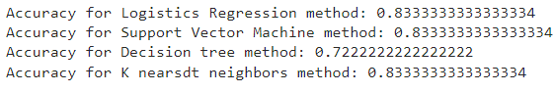
Predictive Analysis (Classification)
Various algorithms were used to build, train, and test a ML algorithm to predict launch outcomes. KNN, SVM, Logistic Regression, and decision trees were used.
Notebook link: https://github.com/Wgorospe/IBM-Data-Science-Capstone/blob/main/SpaceX%20ML%20Prediction.ipynb

Slide 16
Results
SVM, KNN, and Logistic Regression had equal accuracy for detecting launch outcomes
Low weight payloads had a higher rate of success
Time and launch success are directly proportional.
ES-L1, GEO, HEO, and SSO orbits were the most successful

Slide 17

Section 2

Slide 18

Flight Number vs. Launch Site
Flight outcomes were plotted based on the launch site and flight number. An increase in the flight number displays an increase in the success rates.

Slide 19
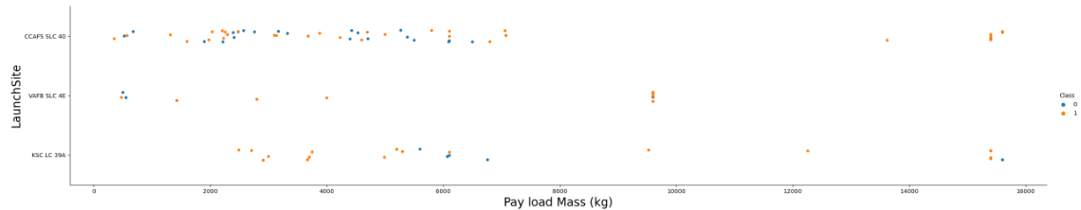
Payload vs. Launch Site
Flight outcomes were plotted based on payload mass (kg) and launch sites. CCAFS SLC 40 had the highest total of launches.

Slide 20
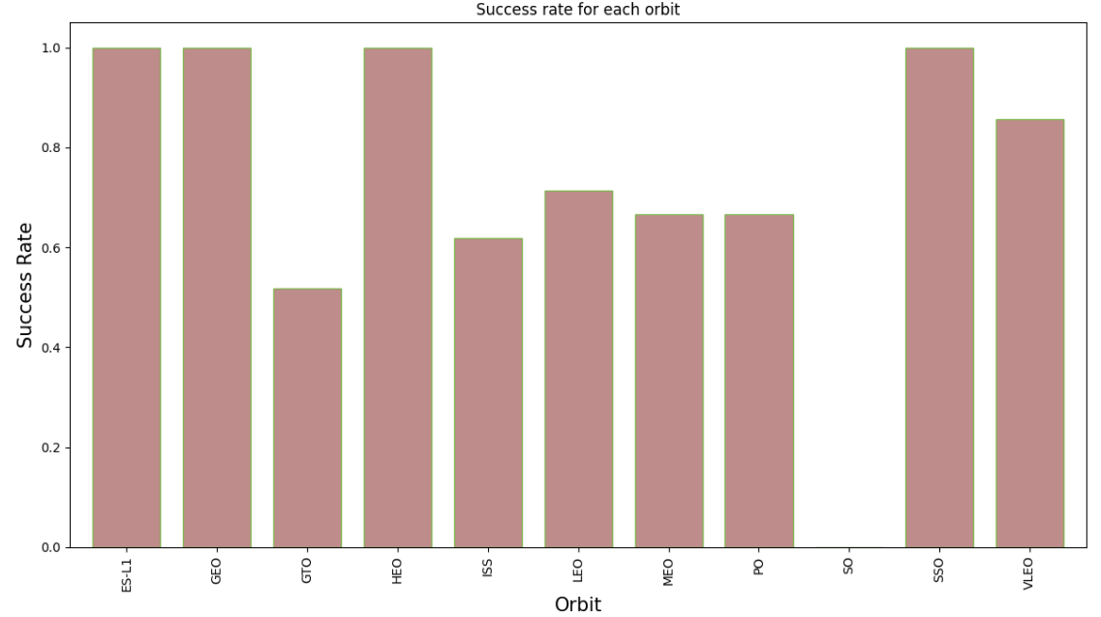
Success Rate vs. Orbit Type
The bar chart shows the success rate for each type of orbit. ES-L1, GEO, HEO, and SSO had 100% success rates.

Slide 21
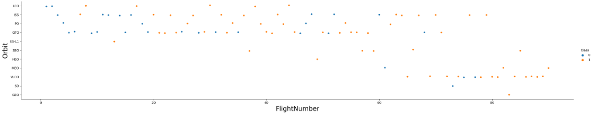
Flight Number vs. Orbit Type
Flight outcomes were plotted based on flight number and orbit type. Higher flight numbers displayed an increase in VLEO orbit type as well as overall success rates.

Slide 22
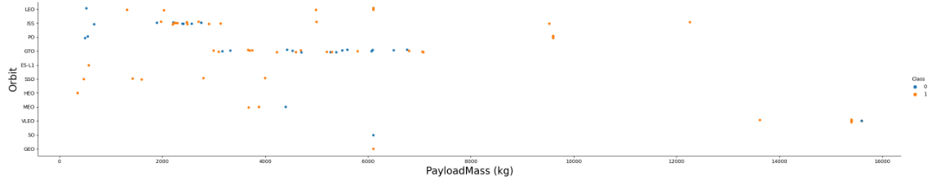
Payload vs. Orbit Type
Flight outcomes were plotted based on orbit type and payload mass (kg). Lighter payloads resulted in a higher success rate.

Slide 23
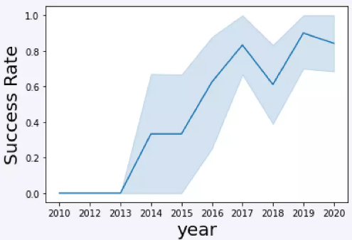
Launch Success Yearly Trend
A line chart displaying the success rate over a decade displays the overall increase in success for most years.

Slide 24
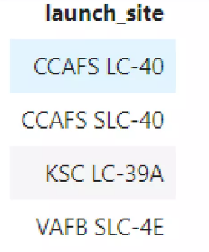
All Launch Site Names
%sql SELECT UNIQUE(LAUNCH_SITE) FROM SPACEXTBL;

Slide 25
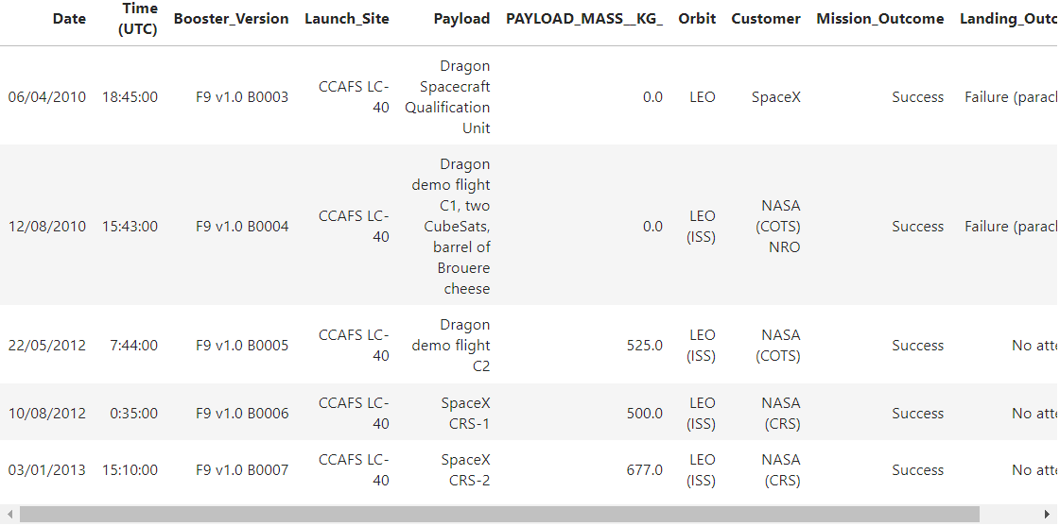
Launch Site Names Begin with 'CCA'
%sql SELECT * FROM SPACEXTBL WHERE LAUNCH_SITE LIKE 'CCA%' LIMIT 5;

Slide 26
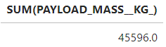
Total Payload Mass
%sql SELECT SUM(PAYLOAD_MASS__KG_) FROM SPACEXTBL WHERE CUSTOMER = 'NASA (CRS)';

Slide 27
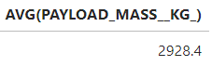
Average Payload Mass by F9 v1.1
%sql SELECT AVG(PAYLOAD_MASS__KG_) FROM SPACEXTBL WHERE BOOSTER_VERSION = 'F9 v1.1';

Slide 28
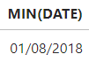
First Successful Ground Landing Date
%sql SELECT MIN(DATE) FROM SPACEXTBL WHERE LANDING_OUTCOME = 'Success (ground pad)';

Slide 29
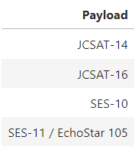
Successful Drone Ship Landing with Payload between 4000 and 6000
%sql SELECT PAYLOAD FROM SPACEXTBL WHERE LANDING_OUTCOME = 'Success (drone ship)' AND PAYLOAD_MASS__KG_ BETWEEN 4000 AND 6000;

Slide 30
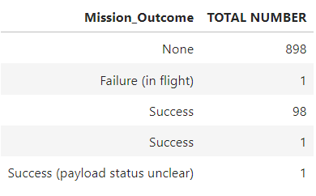
Total Number of Successful and Failure Mission Outcomes
%sql SELECT MISSION_OUTCOME,COUNT(*) AS 'TOTAL NUMBER' FROM SPACEXTBL GROUP BY MISSION_OUTCOME;

Slide 31
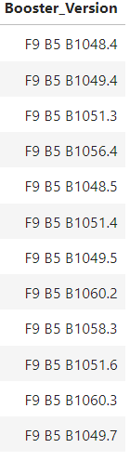
Boosters Carried Maximum Payload
%sql SELECT BOOSTER_VERSION FROM SPACEXTBL WHERE PAYLOAD_MASS__KG_ = (SELECT MAX(PAYLOAD_MASS__KG_) FROM SPACEXTBL);

Slide 32
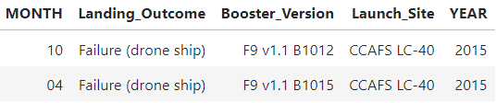
2015 Launch Records
%sql SELECT SUBSTR(DATE,4,2) AS 'MONTH',LANDING_OUTCOME,BOOSTER_VERSION,LAUNCH_SITE,SUBSTR(DATE,7,4) AS YEAR FROM SPACEXTBL WHERE YEAR = '2015' AND LANDING_OUTCOME = 'Failure (drone ship)';

Slide 33
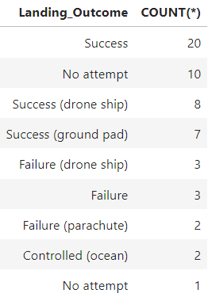
Rank Landing Outcomes Between 2010-06-04 and 2017-03-20
%sql SELECT LANDING_OUTCOME,COUNT(*) FROM SPACEXTBL WHERE DATE between '04-06-2010' and '20-03-2017' GROUP BY LANDING_OUTCOME ORDER BY COUNT(LANDING_OUTCOME) DESC;

Slide 34

Section 3

Slide 35
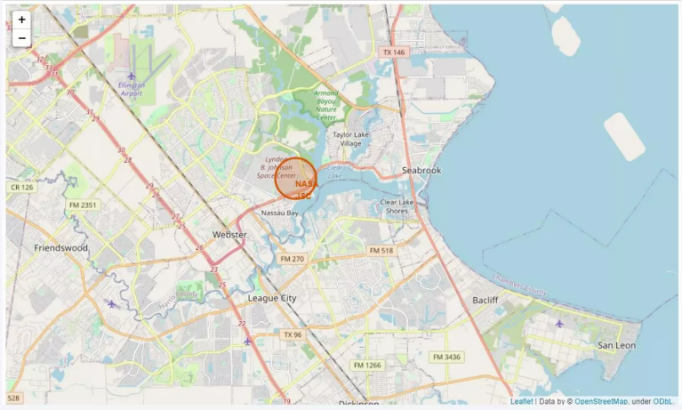
All Launch Sites Marked on Map

Slide 36
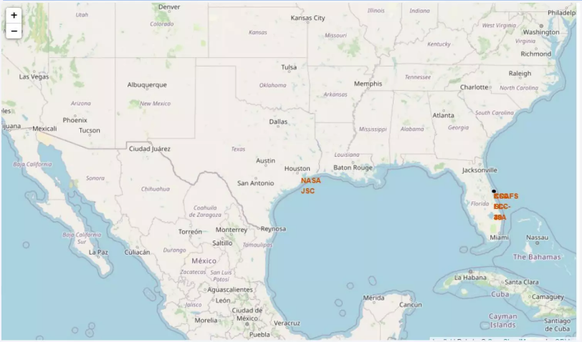
Successful / Failed Launches

Slide 37
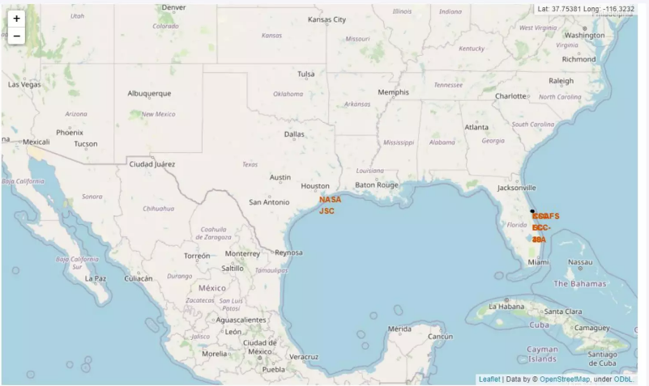
Distances Between Launch Sites to its Proximities

Slide 38

Section 4

Slide 39

Total Successful Launches by All Sites

Slide 40

Success Rate by Site

Slide 41

Payload vs Launch Outcome

Slide 42

Section 5

Slide 43
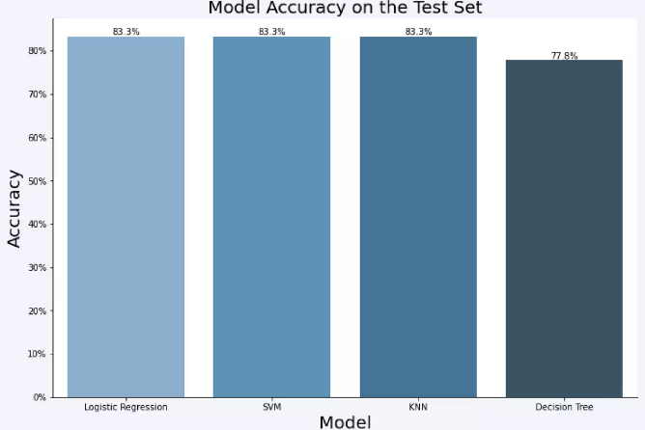
Classification Accuracy
Logistic Regression, SVM, and KNN had equal prediction accuracy at 83.33%.

Slide 44
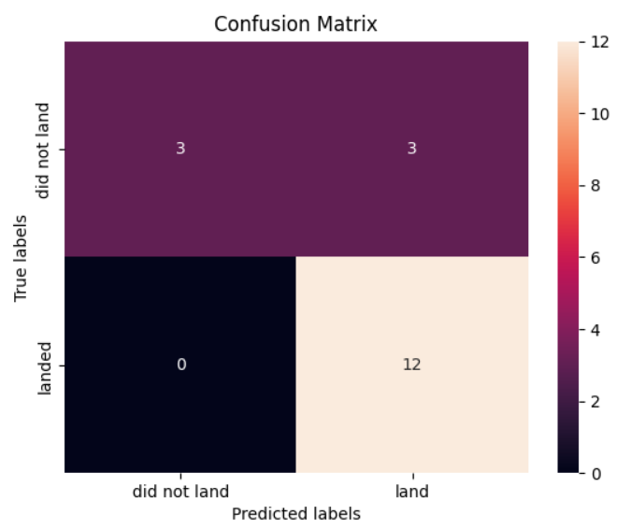
Confusion Matrix
Logistic Regression, SVM, and KNN had the same confusion matrix. There were 3 incorrect labels out of the total 18. All did not land predictions were correct.

Slide 45
Conclusions
SVM, KNN, and Logistic Regression provide equal analysis accuracy
Low weighted payloads are more successful
SpaceX success rates can expect to increase as time increases
KSC LC 39A was the most successful launch site
GEO, HEO, SSO, ES-L1 are equal in success rates for orbit types

Slide 46
Appendix
Include any relevant assets like Python code snippets, SQL queries, charts, Notebook outputs, or data sets that you may have created during this project

Slide 47


